Slide 1

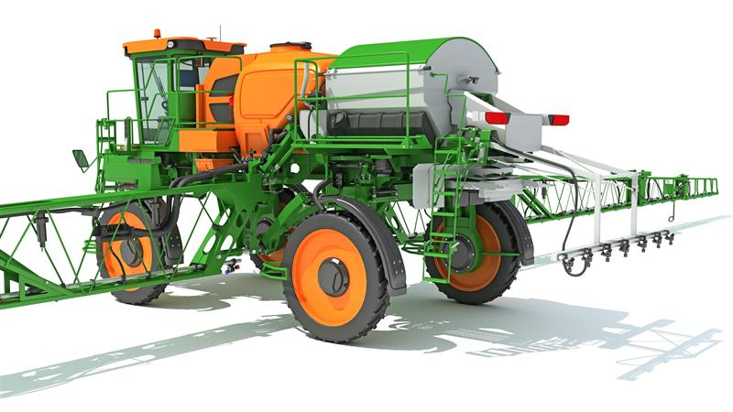
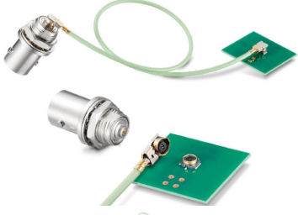
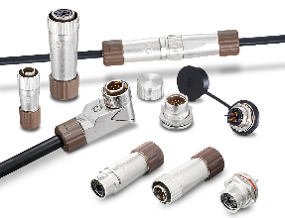
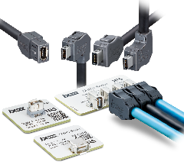
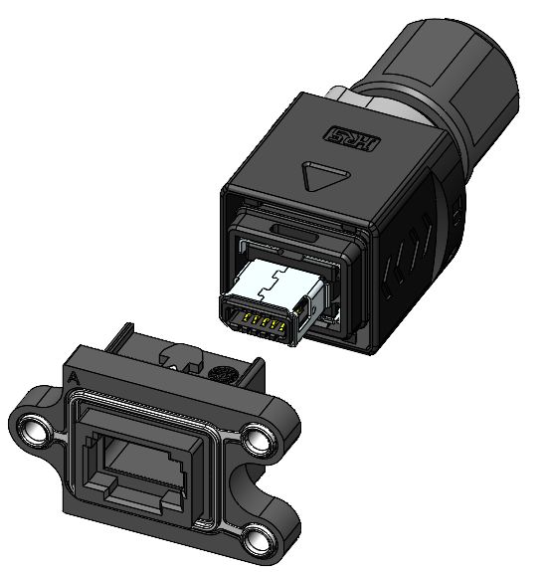
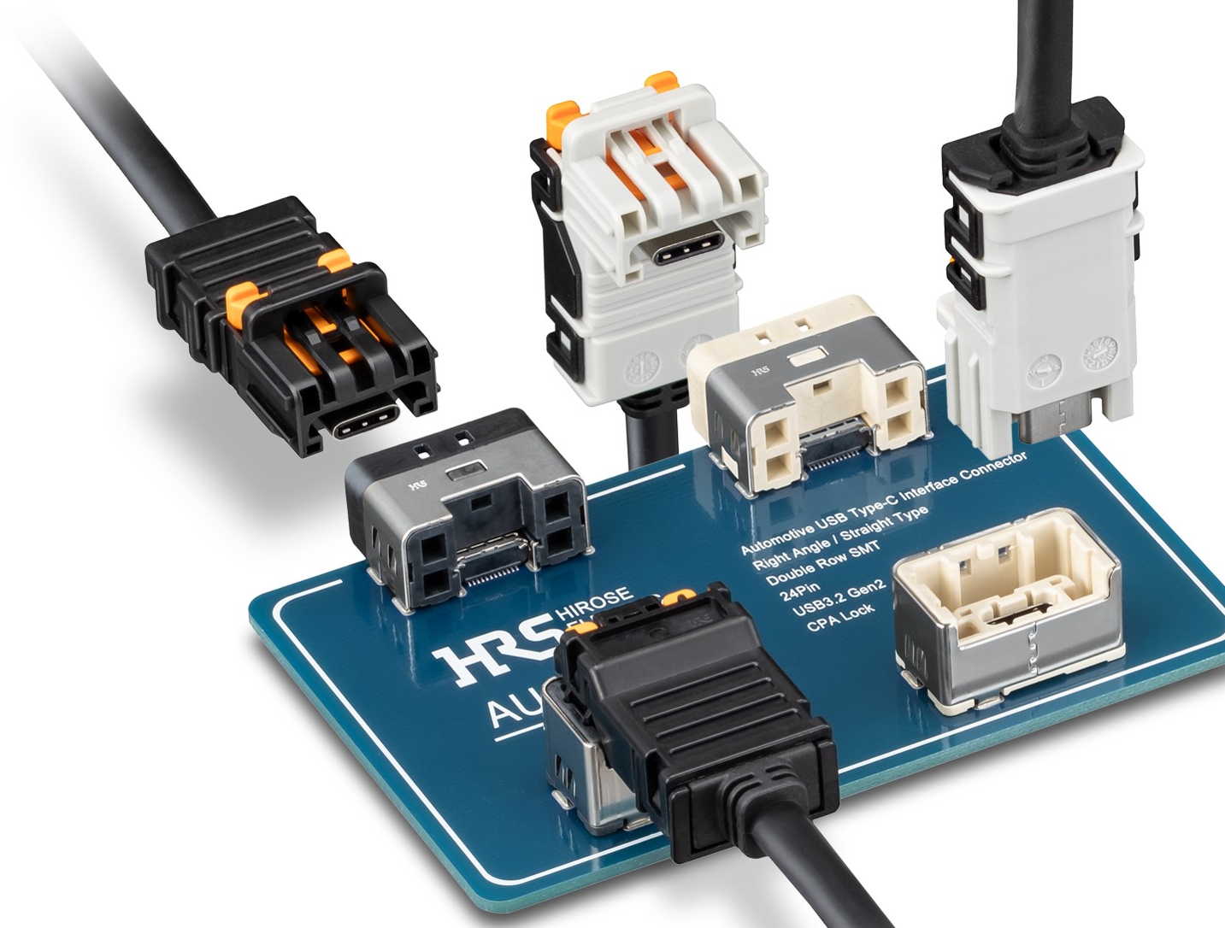
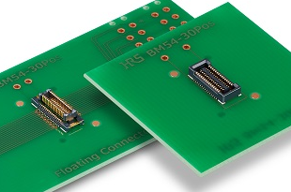
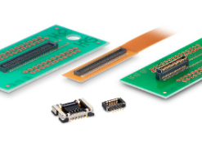
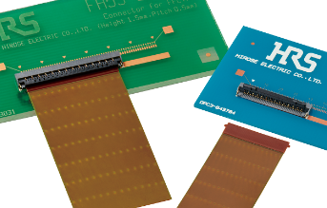
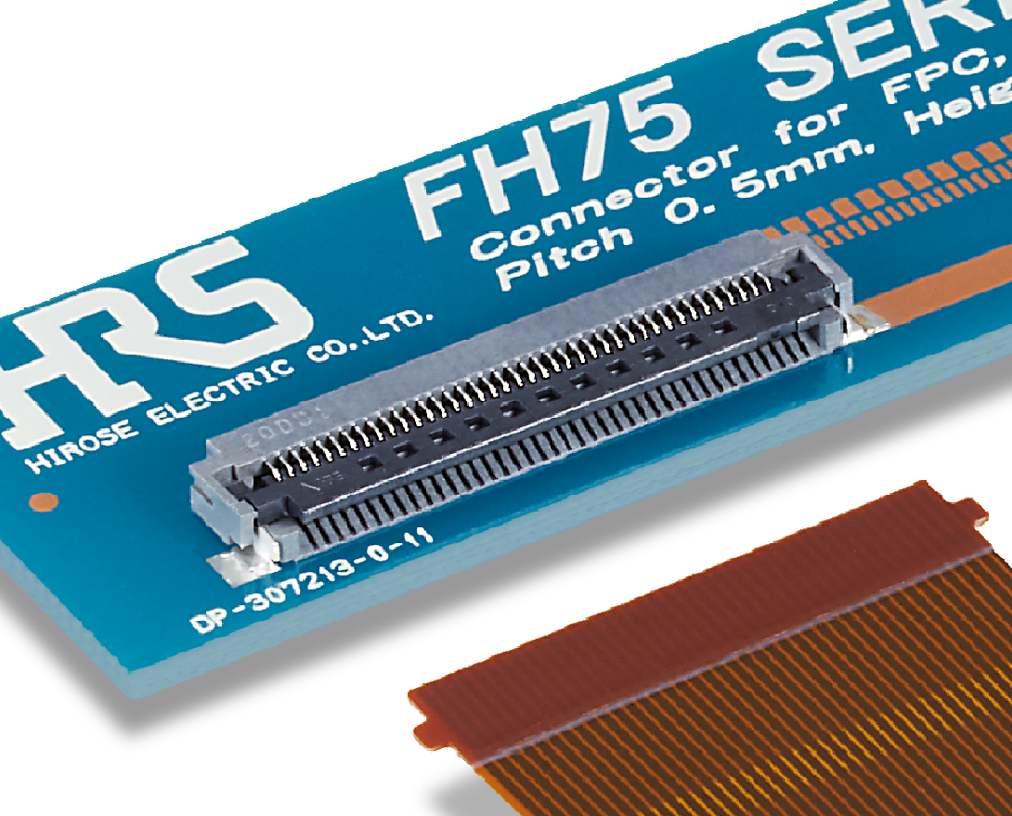
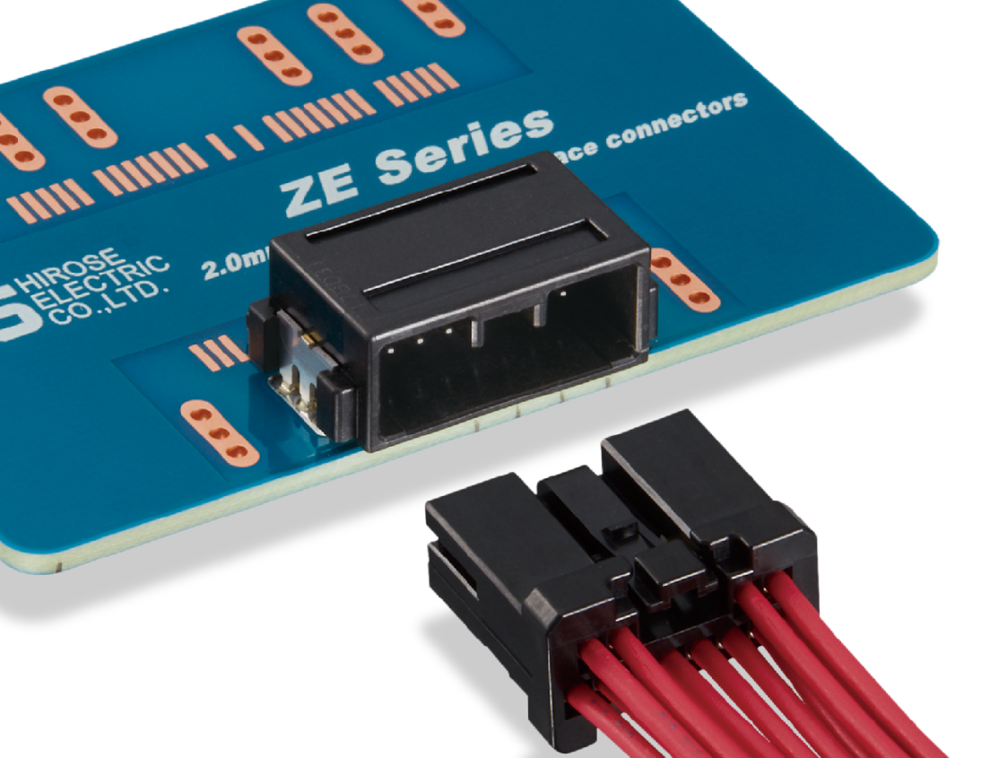
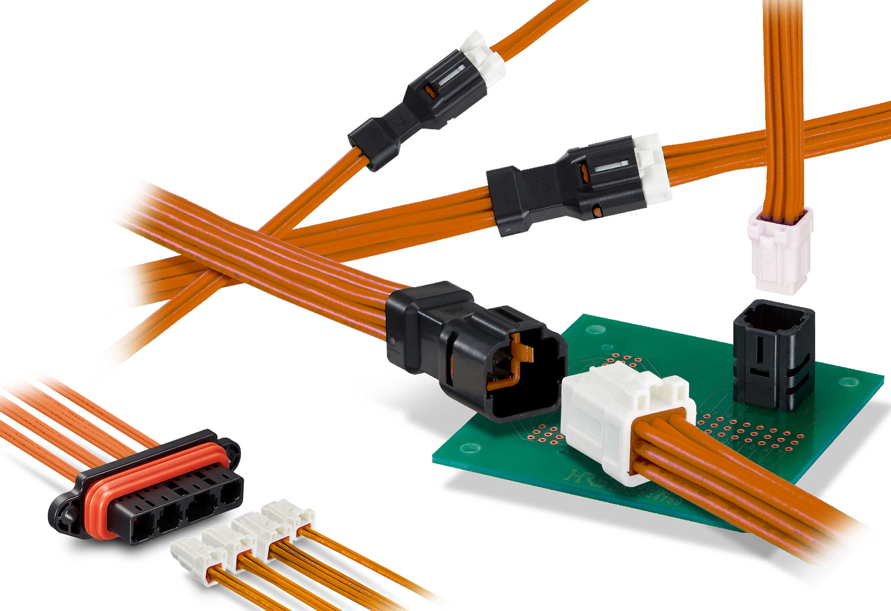
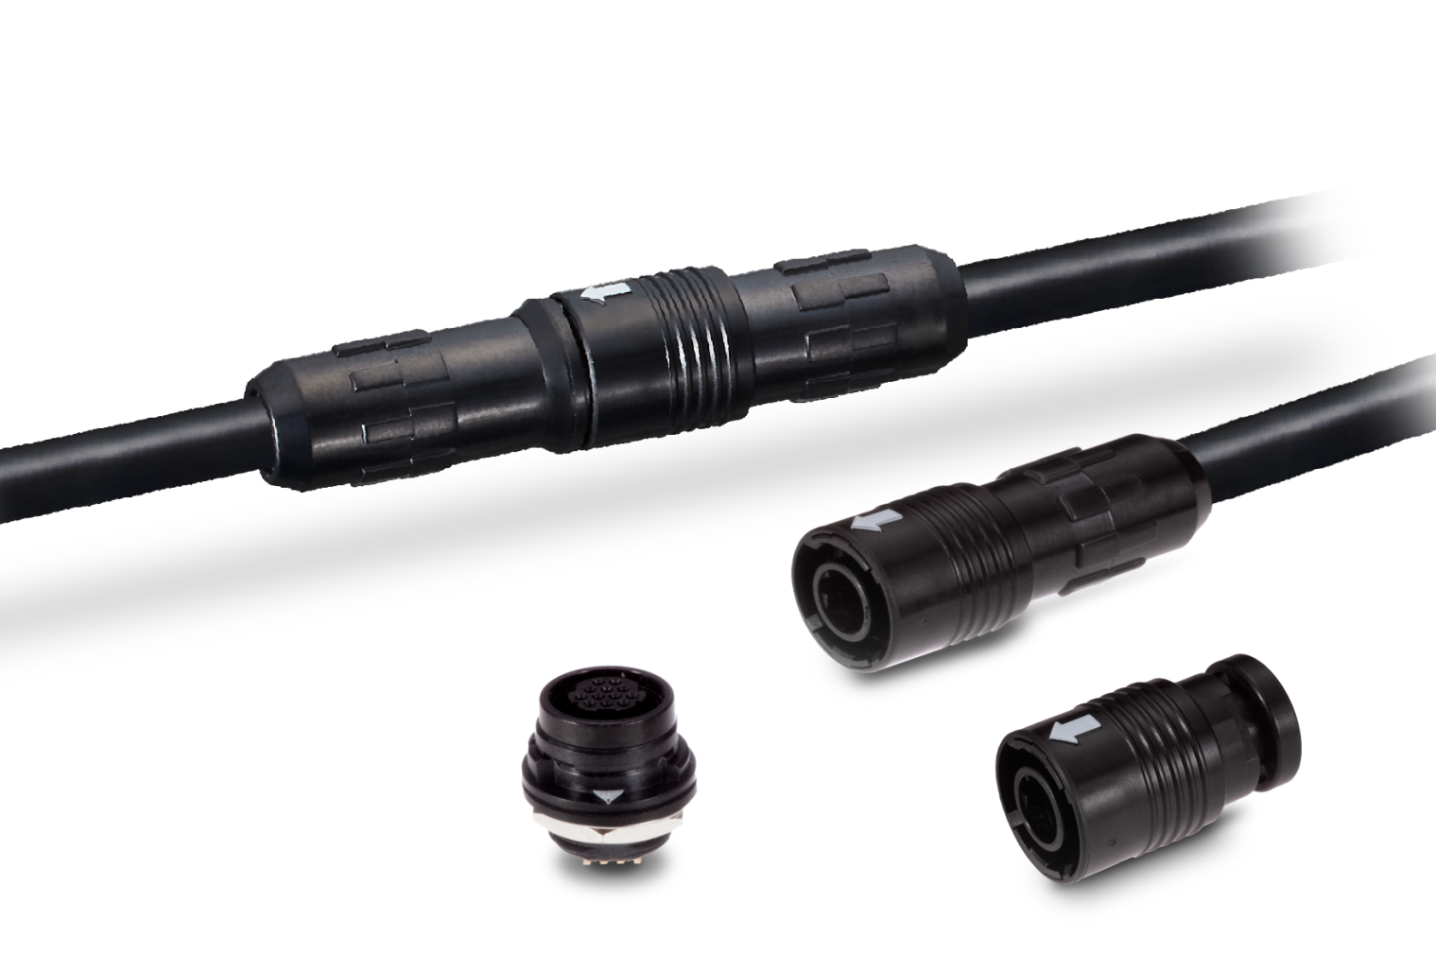
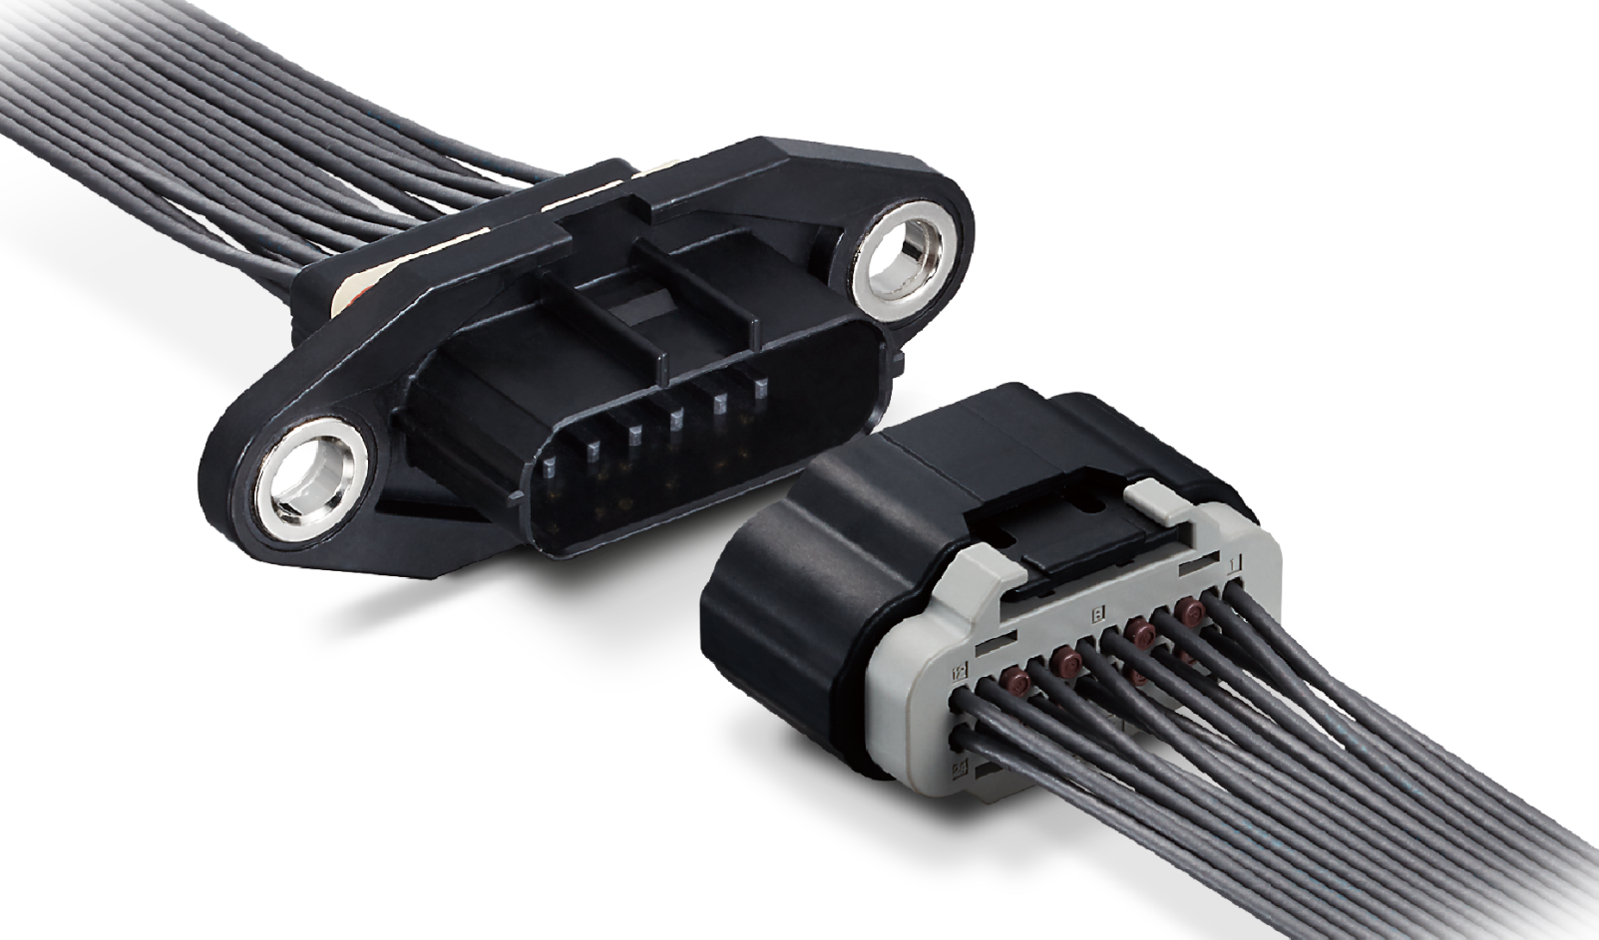
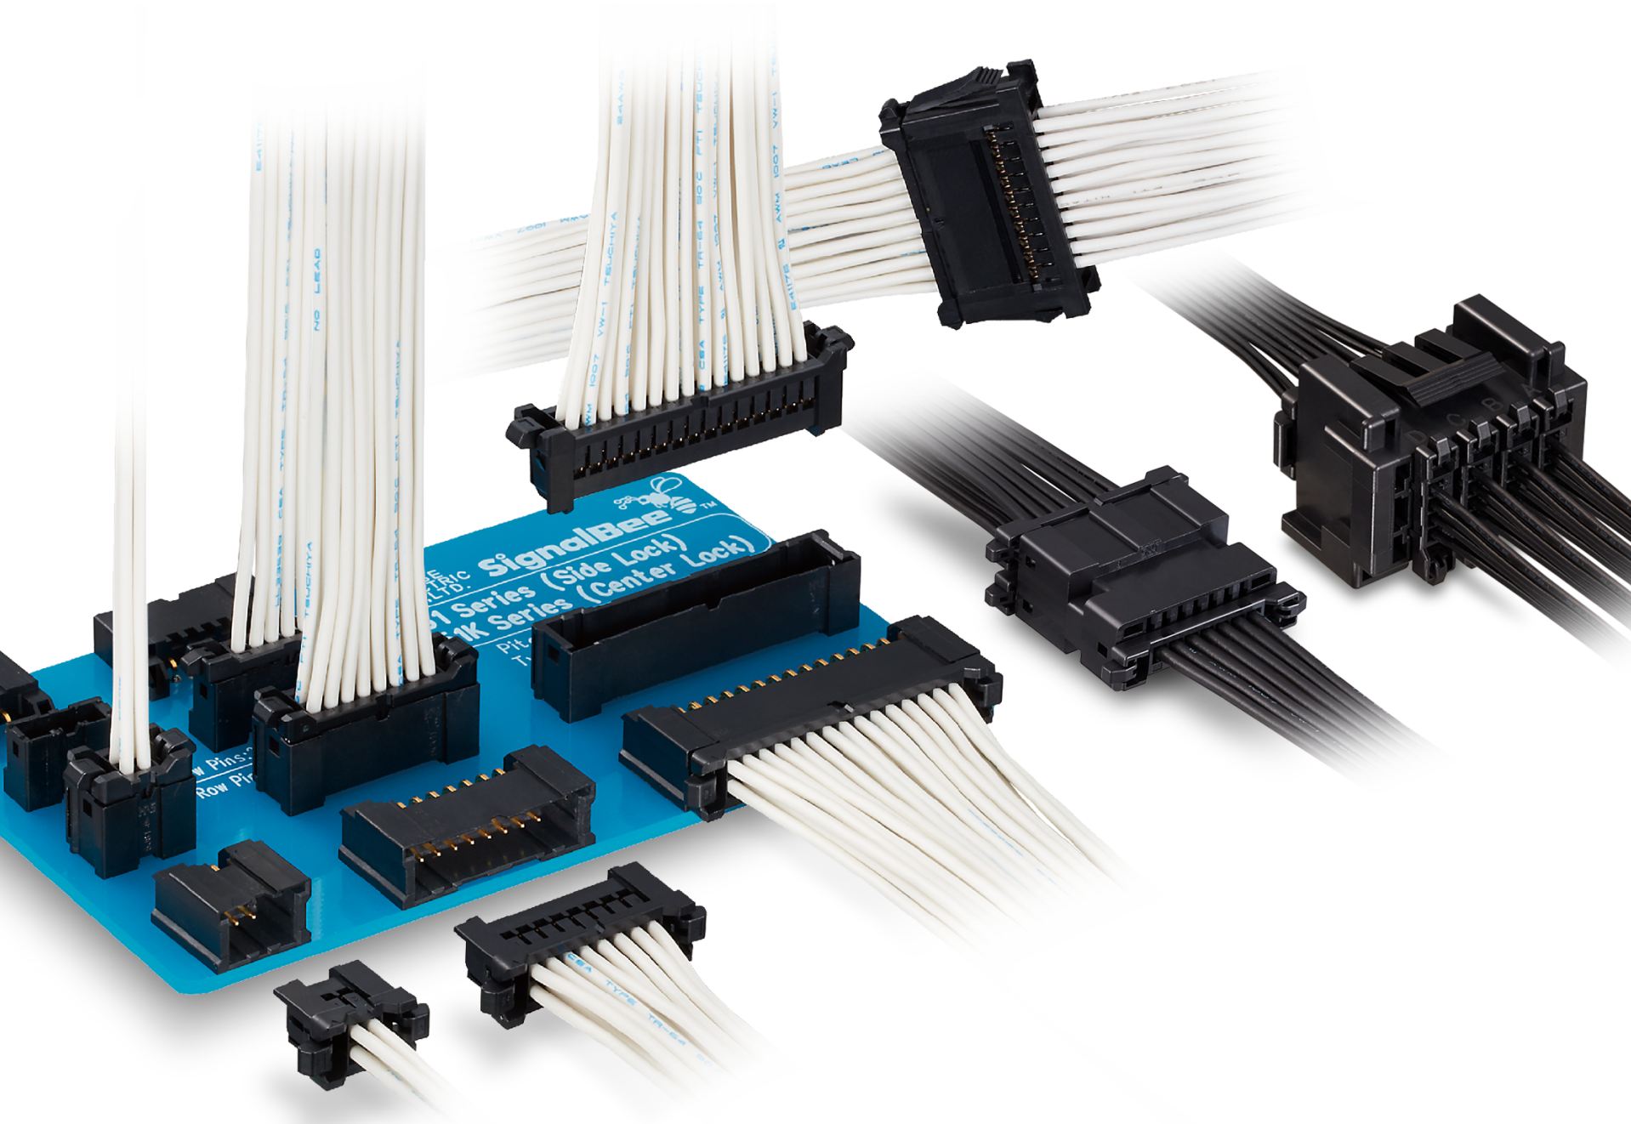
Connectors For Agricultural Sprayer, Vision Camera
Click here to request a sample
1. Computer Vision Camera, Sensors
D.FL75 Series
For Coax Press
75Ω, 12GHz
LF Series
Cat6a, IP67, AWG26-30
Ethernet, GigE
iX Series
Cat6a, IP67 available
Ethernet, GigE
AU1 Series
10Gbps, USCAR-2 and -30
Rugged, USB type C
1
2
2. Internal/Inline Connector for Sensors, Main board and Sub board, Control unit
3
Graphic processor
Machine learning
Display
Bogie
125℃
Height sensor
Radar sensor
Tilt sensor
Ultrasonic sensors
BM54 Series
P=0.4mm, H=3-4.5mm
16Gbps
DF40T Series
P=0.4mm, H=1.5-7mm
Shielding option
FH55/FH55M Series
P=0.4,0.5mm, H=1.5mm
High speed FPC
FH75/FH75M Series
P=0.4,0.5mm, H=2.0mm
High Retention Force
Control board
Data management
Motor
Valve switch on/off
Boom
ZE05 Series
P=2.0mm, AWG20-22
Up to 125ºC
DF51 Series
P=2.0mm, AWG22-30
Branch type for multiple sensors
DF62W Series
P=2.2mm, AWG20-26
IP67
HR30 Series
Cat5e, 26-30
Small, Light weight
ZE064W Series
P=2.2, AWG20-22
IP67/69K
Spray nozzle
Cameras
Click on the product for more information
2025-07-22 HS

Slide 2
Connectors For Agricultural Sprayer, Vision Camera (cont.)
Click here to request a sample
Terrain/Height sensors
Moisture
sensors
Terrain/Height sensors
Motors
2
ISOBUS, CANBUS
1
PLC
PC
3
Bogie
Data Transmit Protocol (see table)
Gateway switch
125℃
Data Transmit Protocol (see table)
protocol | Max.speed | Length | HRS Connector
GigE Vision | 10Gbps | 100m- | iX, RJ45, LF, TM11R …
CoaXPress | 12.5Gbps | 85m- | BNC75, MRF20, PL75, D.FL75
Camera Link | 855Mbps | 4m
Camera Link HS | 8.4Gbps | 15m- | Fiber optic (BF4-IR2), SW20
USB3 Vision | 20Gbps | 3-5m- | CX
Camera
Spray valve/Nozzle
Camera
Spray valve/Nozzle
Click on the product for more information
2025-07-22 HS

