Slide 1















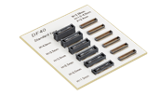



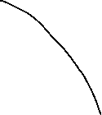
Hirose Connectors – GNSS Antenna/Receiver
Click here to request a sample
1. Main board to Antenna module
Shielded
2.5A/pin+0.3A/pin
Clear Tactile Click
High Frequency
RF switch
External Antenna
Embedded PCB antenna
U.FL-K Series
8GHz, Gold plating
SMA(R) Series
26.5GHz, FL conversion adaptor
MS-156C Series
BK35 Series
P=0.35mm, H=0.6mm
Coax cable
USB
Bluetooth
WiFi
Power line (12pos)
2. I/O (Power, Signal Transmission)
IP67*
Small, Light weight
Vibration Resistance
Robust
Control Panel
DF62WZ Series
P=2.2mm, AWG20-26
HR30 Series
Max.5A/pin, AWG26-30
HR34B Series
Max.5A/pin, AWG20-25
CX Series
20Gbps, Max.6A/pin
3. Internal connection
Vertical Mating
Vibration Resistance
Wide Variation
Wide Variation
High speed
Top & Bottom Contact
DF57 Series
P=1.2mm, AWG26-34
KW30 Series
P=1.0mm, AWG28-32
DF40 Series
P=0.4mm, H=1.5-4.0mm
DF17 Series
P=0.5mm, H=4.0-8.0mm
FH55/FH55M Series
P=0.4, 0.5mm, H=1.5mm
FH34 Series
P=0.5mm, Back flip

Slide 2
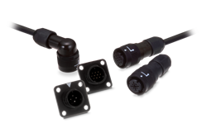
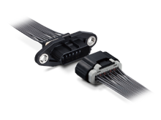
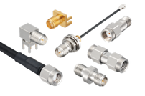
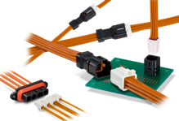
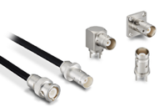
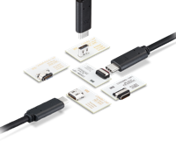
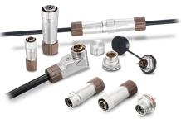
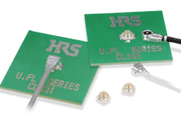
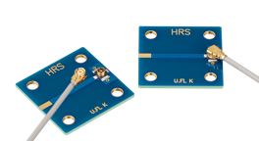
GNSS Antenna/Receiver
SMA
BNC
U.FL(A)
U.FL-K
BK35
ZE064W + ZE05
DF62W
HR34B
LF
CX, IX
RS232
Interface
External
antenna
CANBUS
Interface
Analog signal
Radio wave[Hz]
Antenna
module
Amplifier
ADC
Receiver
module
NMEA
0183/2000
Analog to Digital
USB
Ethernet
Display Board
Display Board

