Slide 1


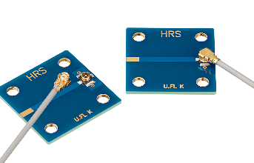
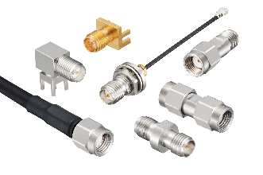
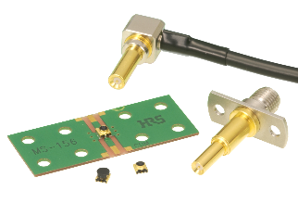
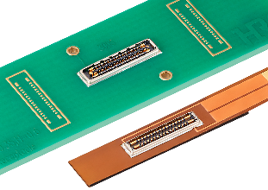
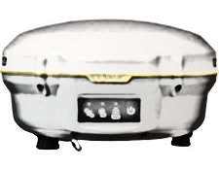
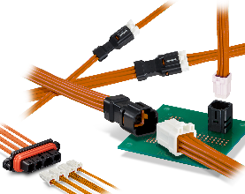
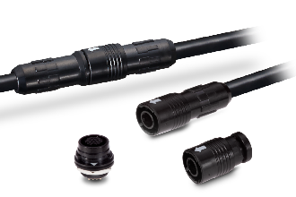


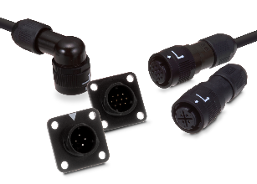
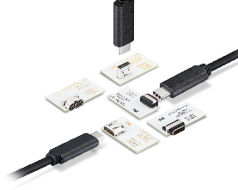
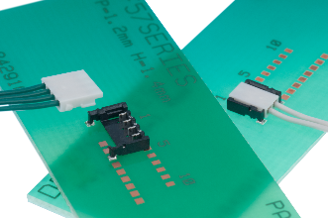
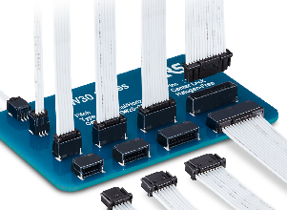
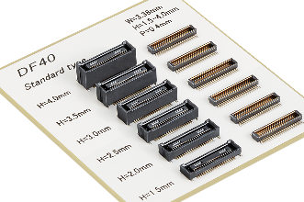
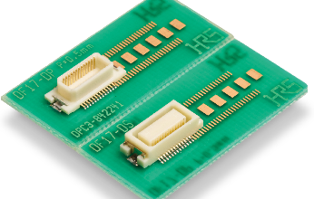
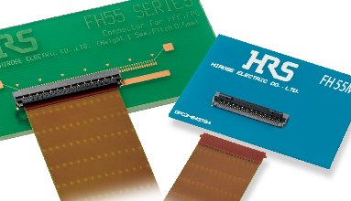
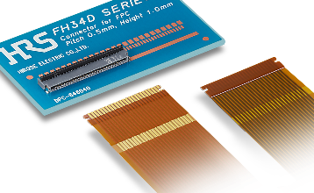
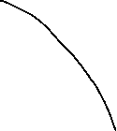
Hirose Connectors – GNSS Antenna/Receiver
Click here to request a sample
1. Main board to Antenna module
External Antenna
Embedded PCB antenna
U.FL-K Series
8GHz, Gold plating
Clear Tactile Click
SMA(R) Series
26.5GHz, FL conversion adaptor
High Frequency
MS-156C Series
RF Switch
BK35 Series
P=0.35mm, H=0.6mm
2.5A/pin+0.3A/pin, Shielded
2. I/O (Power, Signal Transmission)
Coax cable
USB
Bluetooth
WiFi
Power line (12pos)
Control Panel
DF62WZ Series
P=2.2mm, AWG20-26
IP67*
HR30 Series
Max.5A/pin, AWG26-30
Small, Light Weight
HR34B Series
Max.5A/pin, AWG20-25
Vibration Resistance
CX Series
20Gbps, Max.6A/pin
Robust
3. Internal connection
DF57 Series
P=1.2mm, AWG26-34
Vertical Mating
KW30 Series
Vibration Resistance
P=1.0mm, AWG28-32
DF40 Series
P=0.4mm, H=1.5-4.0mm
Wide Variation
DF17 Series
P=0.5mm, H=4.0-8.0mm
Wide Variation
FH55/FH55M Series
P=0.4, 0.5mm, H=1.5mm
High Speed
FH34 Series
Top & Bottom Contact
P=0.5mm, Back flip
Click on the product for more information
2025-08-13 HS

Slide 2
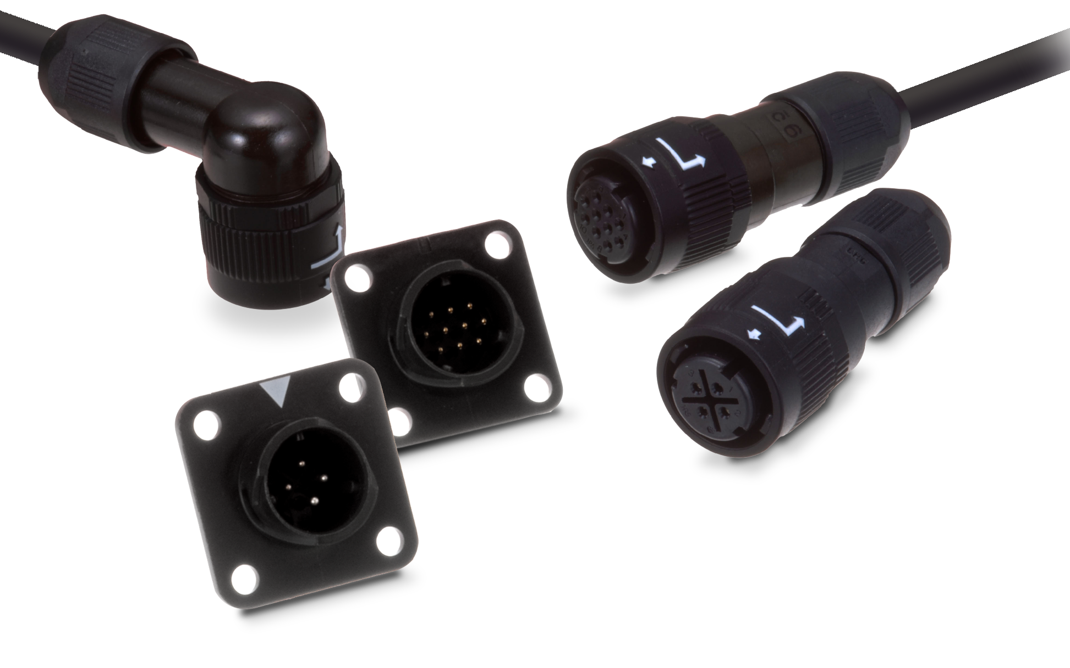

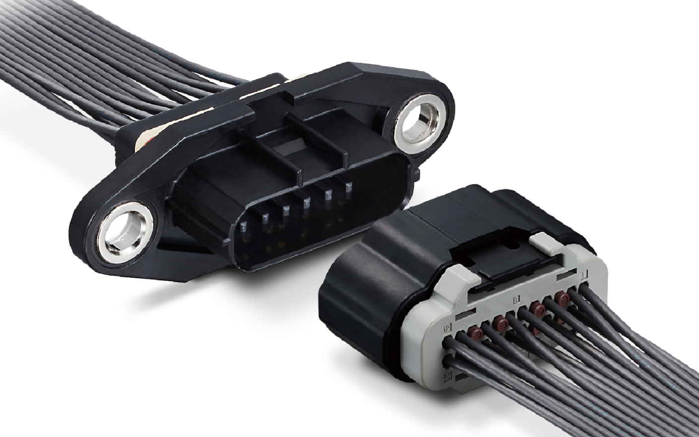

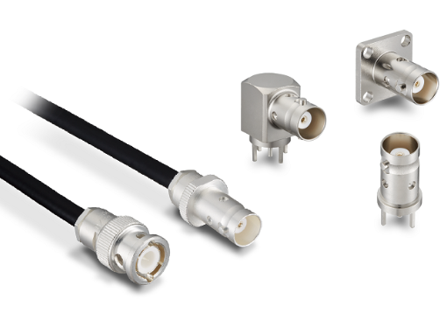
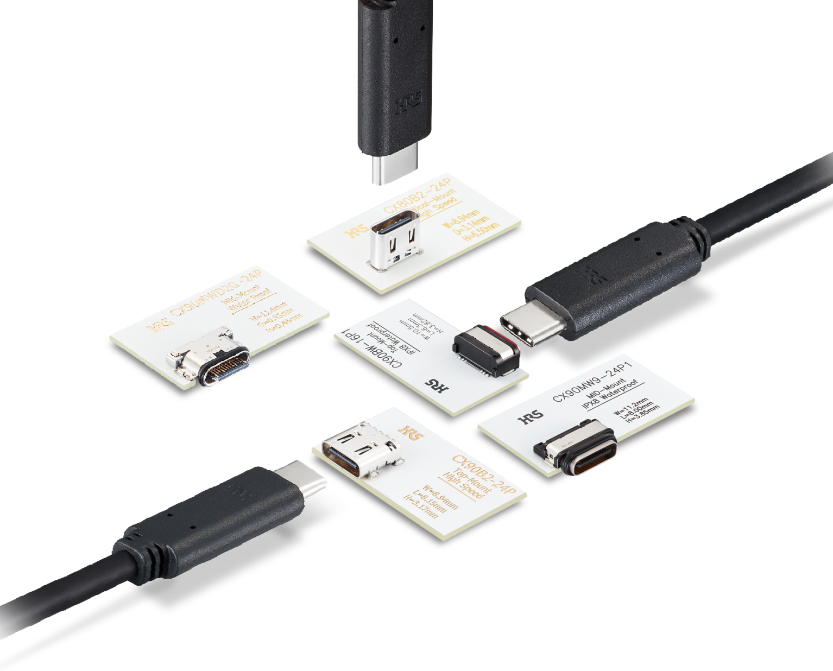
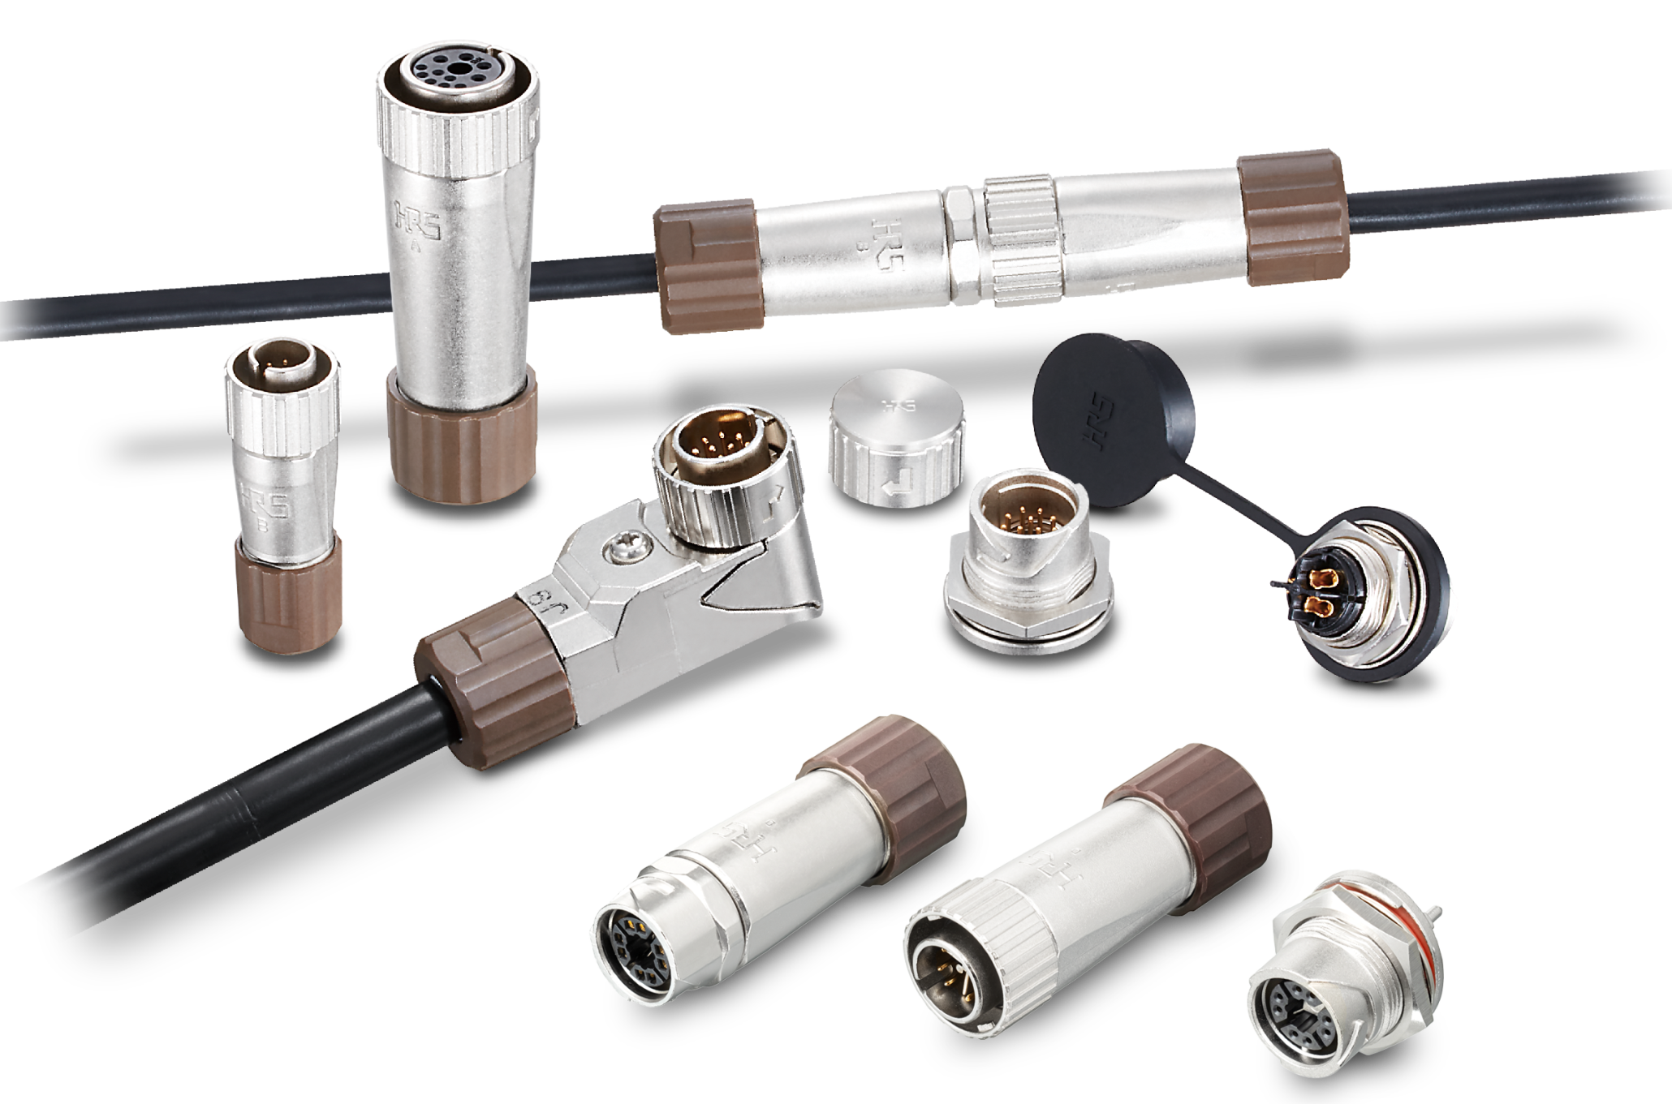
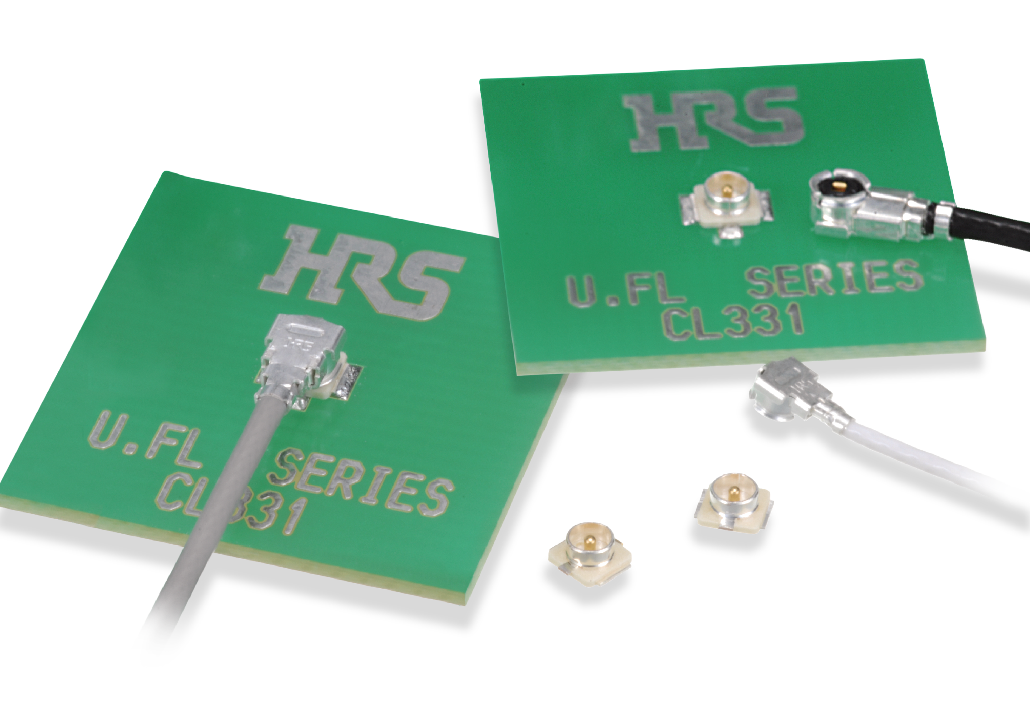

Hirose Connectors – GNSS Antenna/Receiver (cont.)
Click here to request a sample
High Speed Transmission Board-to-Board SMT Connector (Mezzanine, Vertical, Coplanar )
SMA
BNC
U.FL(A)
U.FL-K
BK35
ZE064W + ZE05
DF62W
HR34B
LF
CX, iX
Bogie
RS232
Interface
External
antenna
CANBUS
Interface
Analog signal
Radio wave[Hz]
Antenna
module
Amplifier
ADC
Receiver
module
NMEA
0183/2000
Analog to Digital
USB
Display Board
Ethernet
Click on the product for more information
2025-08-13 HS

