Slide 1

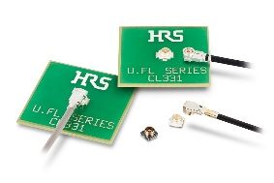
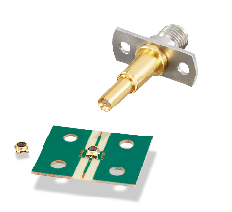
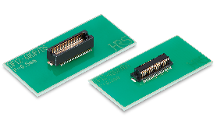
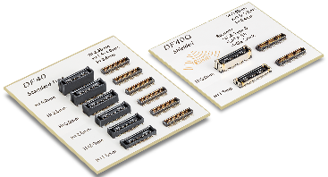
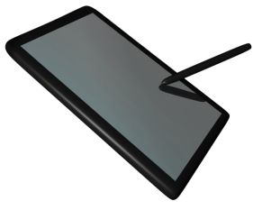
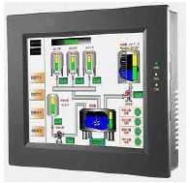
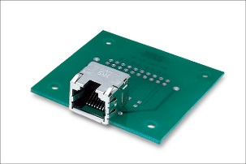
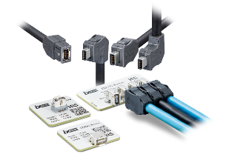
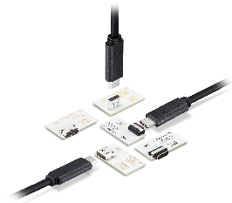
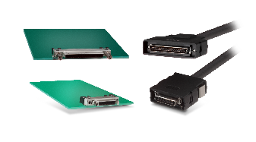
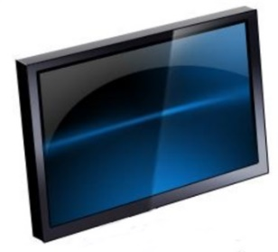


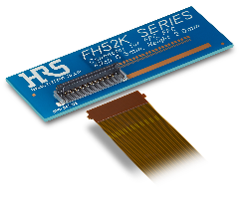
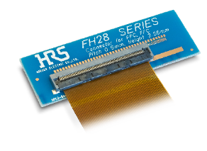
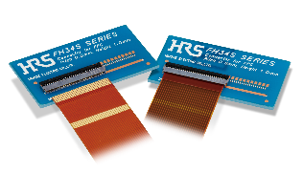
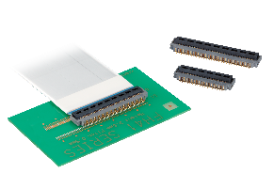
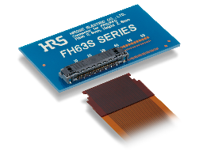



Connectors For Human Machine Interface (HMI)
Small and Low-Profile RF
Board-to-Board
Click here to request a sample
U.FL
DF12N
DF40
Mated Height: 1.9-2.4mm
Applicable Cable:
ø0.81/0.95/1.13/1.32/1.37mm
Frequency: 0 to 18GHz
MS-156C
Pitch: 0.5mm
Stacking Height: 3-5.0mm
No. of Pos.: 10-80
Pitch:0.4mm
Stacking Height: 1.5-4.0mm
No. of Pos.: 10-120
Switch for Module Functionality Inspection
Height: 1.35mm
Frequency: 0 to 11GHz
V.S.W.R.: 1.5 Max.
Handy Terminal▲
Small Interface
Bogie
▲Embedded
Display Panels
TM11R
CX
DH
IX
RJ45
EMI Modular Jack
Cat.6A Ethernet
Small and Robust
USB Type-C
USB4 Gen. 2x2
1mm Pitch
High Speed, Small
Industrial Panels▲
FPC/FFC
FH52K
FH28K
FH34
FH41
FH63S
Robust
Pitch: 0.5/1.0mm
Height: 2.0mm
No. of Pos.: 6-80
Robust
Pitch: 0.5mm
Height: 2.55mm
No. of Pos.: 10-80
Compact
Pitch: 0.5mm
Height: 1.0mm
No. of Pos.: 4-50
Supported Shielded FFC
Pitch: 0.5mm
Height: 2.5mm
No. of Pos.: 15-68
One Action
Pitch: 0.5mm
Height: 2.8mm
No. of Pos.: 10-50
Click on the product for more information
2025-07-16 HS

Slide 2
Connectors For Human Machine Interface (HMI)
Small and Low-Profile RF
Board-to-Board
Click here to request a sample
U.FL
DF12N
DF40
Mated Height: 1.9-2.4mm
Applicable Cable:
ø0.81/0.95/1.13/1.32/1.37mm
Frequency: 0 to 18GHz
MS-156C
Pitch: 0.5mm
Stacking Height: 3-5.0mm
No. of Pos.: 10-80
Pitch:0.4mm
Stacking Height: 1.5-4.0mm
No. of Pos.: 10-120
Switch for Module Functionality Inspection
Height: 1.35mm
Frequency: 0 to 11GHz
V.S.W.R.: 1.5 Max.
Handy Terminal▲
Small Interface
Bogie
▲Embedded
Display Panels
TM11R
CX
DH
IX
RJ45
EMI Modular Jack
Cat.6A Ethernet
Small and Robust
USB Type-C
USB4 Gen. 2x2
1mm Pitch
High Speed, Small
Industrial Panels▲
FPC/FFC
FH52K
FH28K
FH34
FH41
FH63S
Robust
Pitch: 0.5/1.0mm
Height: 2.0mm
No. of Pos.: 6-80
Robust
Pitch: 0.5mm
Height: 2.55mm
No. of Pos.: 10-80
Compact
Pitch: 0.5mm
Height: 1.0mm
No. of Pos.: 4-50
Supported Shielded FFC
Pitch: 0.5mm
Height: 2.5mm
No. of Pos.: 15-68
One Action
Pitch: 0.5mm
Height: 2.8mm
No. of Pos.: 10-50
Click on the product for more information
2025-07-16 HS

