Slide 1

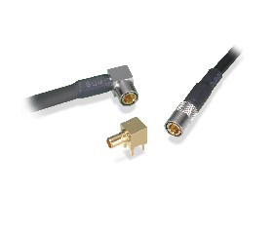
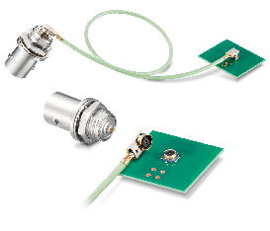
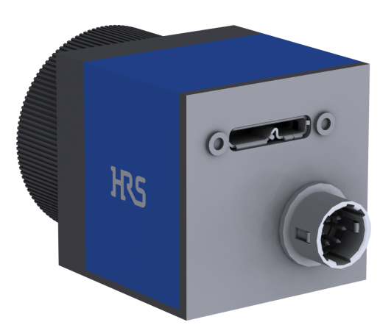
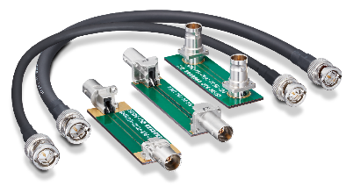
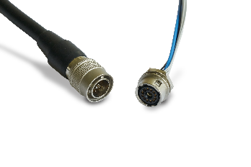
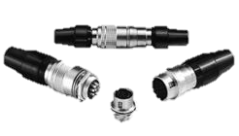
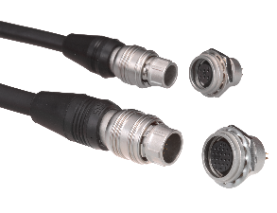
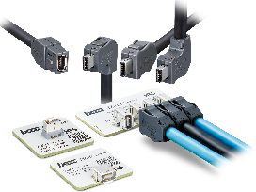
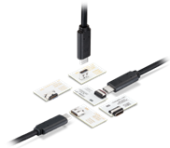
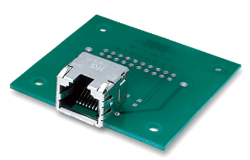






Connectors For Machine Vision
75Ω RF Connector
Click here to request a sample
PL75
D.FL75
BNC75
MRF20
Compact Push-on Lock Connector
3GHz
12G-SDI Standard
Compact 75Ω RF Connector
Coaxial/Power/Signal Hybrid
High Speed Transmission
12G-SDI Standard
BNC75Ω Connector
Circular Connectors for Trigger
IX Connector
USB Connector
RJ45
Technical Road Map of FA
Camera Standards and
HRS Connectors for
Interface
Bogie
HR10
HR25A
De Facto Standard
Rated Current: 2A Max.
No. of Pos.: 4-20
Small Push-Pull Lock Connector
Rated Current: 1A
No. of Pos.: 4-20
IX
CX
TM11R
Small and Robust
Cat.6A Ethernet
Type-C
USB4 Gen. 2×2
EMI Resistance
Modular Jack Connector
10
IX
10Gbps
Cat.6A
PL75
D.FL75
BNC75
6
Note: * is the maximum transmission distance.
CoaXPress
6Gbps / *40m
Camera Link
5.4Gbps / *7m
5
CX
Transmission Speed (Gbps)
5Gbps / *3m
USB3 Vision
TM11R
1
GigE Vision
1Gbps / *100m
IEEE1394
800Mbp / *4.5m
USB2.0
400Mbps
0
2000
2010
2015
(Year)
2005
2020
Click on the product for more information
2025-07-17 HS

Slide 2
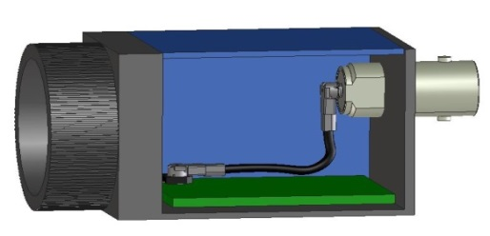
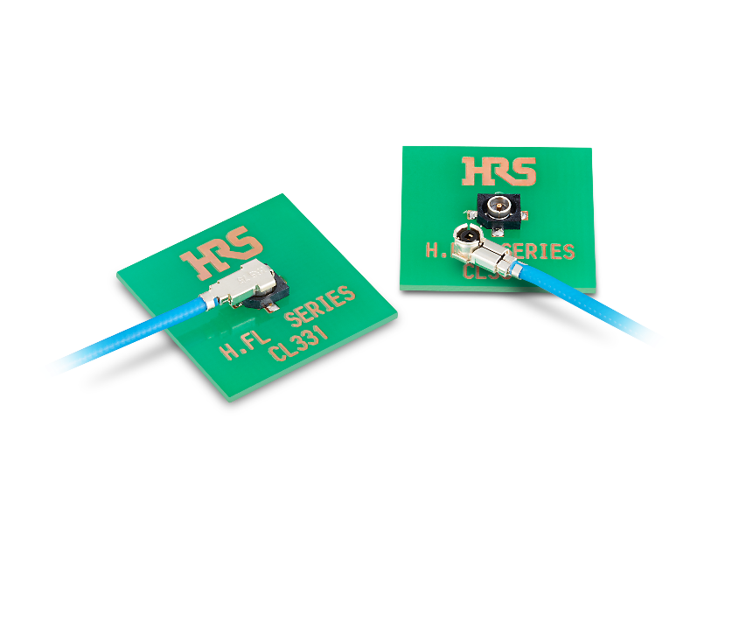
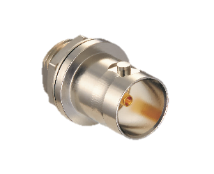

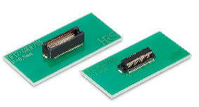
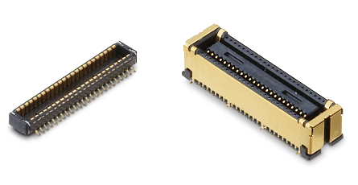
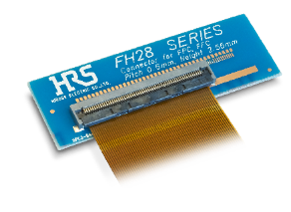
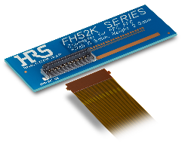
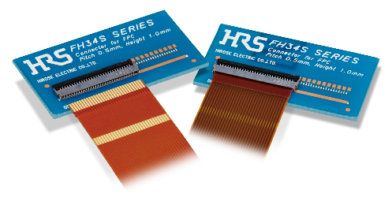
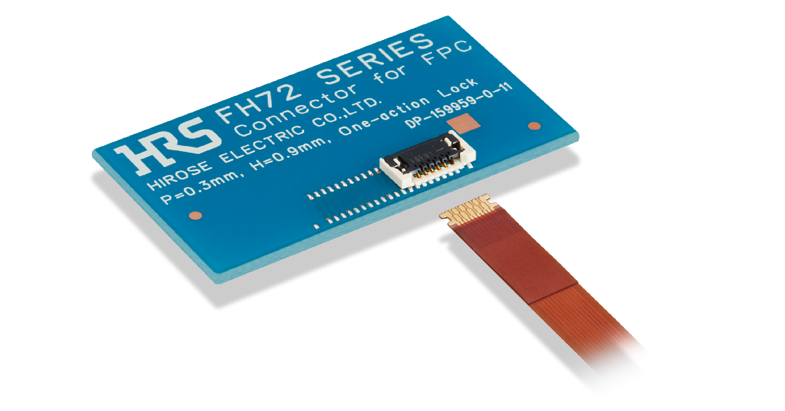
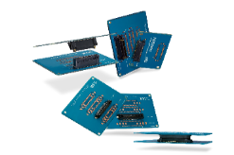
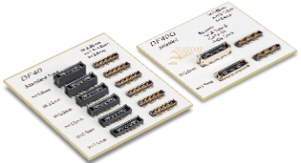


Connectors For Machine Vision (cont.)
Approx. 77% Reduction in PCB
Mounting Space Compared to BNC
Click here to request a sample
Hirose Original Interface Connectors for CoaXPress
Flexible Layout
D.FL75
PL75
⌀7
Standard BNC
⌀14.5
HR10 / HR25
for Trigger
20
PL75
75Ω, Up to 3GHz
Applicable Cable: 1.5C Type
20
Board-to-Board Connector
Bogie
H.FL75
BNC(75)J-H.FLJ
D.FL75
BNC75
3G-SDI Standard
Mated Height: 3.0mm
BNC Connector
with H.FL Adaptor
12G-SDI Standard
Compact 75Ω RF Connector
12G-SDI Standard
BNC75Ω Connector
DF12N
DF40GB
Pitch: 0.5mm
Stacking Height: 3.0-5.0mm
No. of Pos.: 10-80
Shielded Design
Pitch: 0.4mm
Stacking Height: 1.5/3.0/3.5mm
No. of Pos.: 10-70
FPC/FFC Connector
FH28K
FH52K
FH34
FH72
FX23/FX23L
DF40
Pitch: 0.5mm, Height: 2.55mm
Depth: 6.4mm, Bottom Contact
No. of Pos.: 10-80
Pitch: 0.5/1.0mm, Height: 2.0mm
Depth: 5.7mm, Bottom Contact
No. of Pos.: 6-80
Pitch: 0.5mm, Height: 1.0mm
Depth: 3.8mm, Top and Bottom Contact
No. of Pos.: 4-50
Pitch: 0.3mm, Height: 0.9mm
Depth: 3.5mm, Top Contact
No. of Pos.: 11, 15, 21, 31
16Gbps High Speed
Pitch: 0.5mm
Stacking Height:8-30mm
No. of Pos.: 20-120
Pitch: 0.4mm
Stacking Height: 1.5-4.0mm
No. of Pos.: 10-120
Click on the product for more information
2025-07-17 HS

